Slide 1
Chapter 12: Structures & Properties of Ceramics
ISSUES TO ADDRESS...
• How do the crystal structures of ceramic materials
differ from those for metals?
• How do point defects in ceramics differ from those
defects found in metals?
• How are impurities accommodated in the ceramic lattice?
• In what ways are ceramic phase diagrams different from
phase diagrams for metals?
• How are the mechanical properties of ceramics
measured, and how do they differ from those for metals?

Slide 2
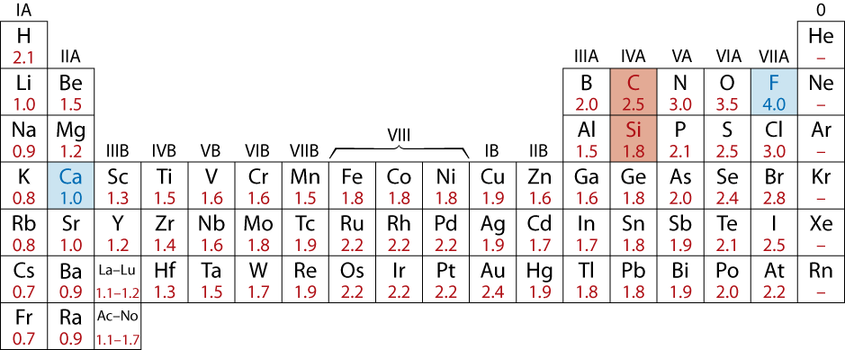
Atomic Bonding in Ceramics
• Bonding:
-- Can be ionic and/or covalent in character.
-- % ionic character increases with difference in
electronegativity of atoms.
• Degree of ionic character may be large or small:
CaF₂: large
SiC: small
Adapted from Fig. 2.7, Callister & Rethwisch 8e. (Fig. 2.7 is adapted from Linus Pauling, The Nature of the Chemical Bond, 3rd edition, Copyright 1939 and 1940, 3rd edition. Copyright 1960 by
Cornell University.)

Slide 3
Ceramic Crystal Structures
Oxide structures
  oxygen anions larger than metal cations
  close packed oxygen in a lattice (usually FCC)
  cations fit into interstitial sites among oxygen ions

Slide 4
Factors that Determine Crystal Structure
1. Relative sizes of ions – Formation of stable structures:
--maximize the # of oppositely charged ion neighbors.
-
-
-
-
-
-
Charge
C. G.
+
+
+
Adapted from Fig. 12.1, Callister & Rethwisch 8e.
-
-
-
-
-
-
unstable
stable
stable
2. Maintenance of
Charge Neutrality :
--Net charge in ceramic
should be zero.
--Reflected in chemical
formula:
F
-
Ca
2+
CaF
2
:
+
anions
cation
F
-
A
m
X
p
m, p values to achieve charge neutrality

Slide 5
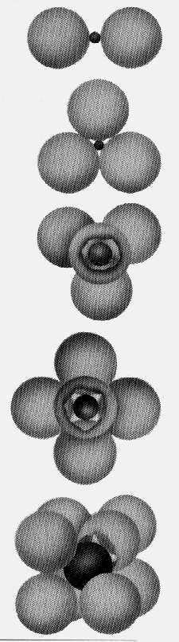
Coordination # and Ionic Radii
r
cation
• Coordination # increases with
UNIT CELL- ATOM RATIO
r
anion
To form a stable structure, how many anions can
surround around a cation?
ION LOCATIONS
r
cation
Coord
#
ZnS
r
anion
(zinc blende)
< 0.155
2
linear
Adapted from Fig. 12.4, Callister & Rethwisch 8e.
0.155 - 0.225
3
triangular
NaCl
(sodium
0.225 - 0.414
4
tetrahedral
chloride)
Adapted from Fig. 12.2, Callister & Rethwisch 8e.
0.414 - 0.732
6
octahedral
CsCl
(cesium
chloride)
0.732 - 1.0
8
cubic
Adapted from Fig. 12.3, Callister & Rethwisch 8e.
Adapted from Table 12.2, Callister & Rethwisch 8e.

Slide 6
Computation of Minimum Cation-Anion Radius Ratio
Determine minimum r_{cation}/r_{anion} for an octahedral site (C.N. = 6)
a = 2r_{anion}

Slide 7
Bond Hybridization
Bond Hybridization is possible when there is significant covalent bonding
  hybrid electron orbitals form
  For example for SiC
    X_{Si} = 1.8 and X_{C} = 2.5
    ~ 89% covalent bonding
    Both Si and C prefer sp³ hybridization
    Therefore, for SiC, Si atoms occupy tetrahedral sites

Slide 8
Example Problem: Predicting the Crystal Structure of FeO
• On the basis of ionic radii, what crystal structure
would you predict for FeO?
Cation
Ionic radius (nm)
• Answer:
Al
3+
0.053
Fe
2
+
0.077
Fe
3+
0.069
Ca
2+
0.100
based on this ratio,
-- coord # = 6 because
0.414 < 0.550 < 0.732
-- crystal structure is NaCl
Anion
O
2-
0.140
Cl
-
0.181
F
-
0.133
Data from Table 12.3, Callister & Rethwisch 8e.

Slide 9
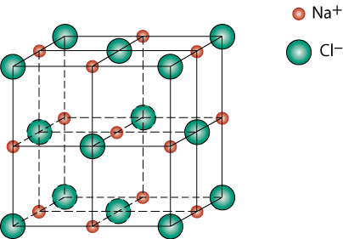
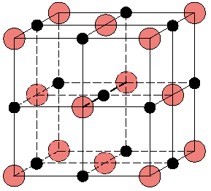
Rock Salt Structure
Same concepts can be applied to ionic solids in general.
Example: NaCl (rock salt) structure
r_{Na} = 0.102 nm
r_{Cl} = 0.181 nm
r_{Na}/r_{Cl} = 0.564
cations (Na⁺) prefer octahedral sites
Adapted from Fig. 12.2, Callister & Rethwisch 8e.

Slide 10

MgO and FeO
MgO and FeO also have the NaCl structure
O²⁻ r_{O} = 0.140 nm
Mg²⁺ r_{Mg} = 0.072 nm
r_{Mg}/r_{O} = 0.514
cations prefer octahedral sites
Adapted from Fig. 12.2, Callister & Rethwisch 8e.
So each Mg²⁺ (or Fe²⁺) has 6 neighbor oxygen atoms

Slide 11
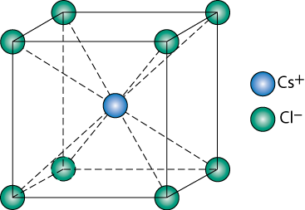
AX Crystal Structures
AX–Type Crystal Structures include NaCl, CsCl, and zinc blende
Cesium Chloride structure:
∴ Since 0.732 < 0.939 < 1.0,
cubic sites preferred
So each Cs⁺ has 8 neighbor Cl⁻
Adapted from Fig. 12.3, Callister & Rethwisch 8e.

Slide 12
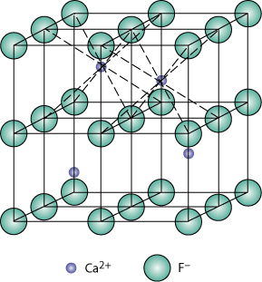
AX₂ Crystal Structures
Fluorite structure
UNIT CELL –TWO DIAGONALS
Calcium Fluorite (CaF₂)
Cations in cubic sites
UO_{2,} ThO₂, ZrO₂, CeO₂
Antifluorite structure –
positions of cations and
anions reversed
Adapted from Fig. 12.5, Callister & Rethwisch 8e.

Slide 13
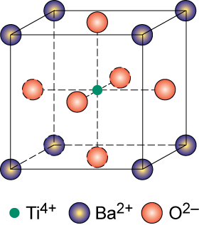
ABX₃ Crystal Structures
Perovskite structure
Ex: complex oxide
BaTiO₃
CHARGE C.G. SEPARATE AT GEOMETRICAL CENTER
Adapted from Fig. 12.6, Callister & Rethwisch 8e.

Slide 14
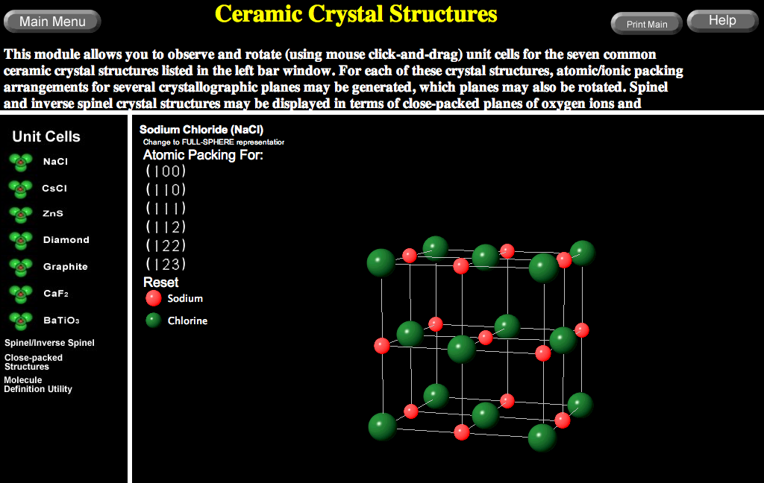
VMSE: Ceramic Crystal Structures

Slide 15
Density Computations for Ceramics
NUMBER OF CAT AND ANION WITHIN AN UNIT CELL
Number of formula units/unit cell
Avogadro’s number
    Volume of unit cell
= sum of atomic weights of all cations in formula unit
= sum of atomic weights of all anions in formula unit

Slide 16
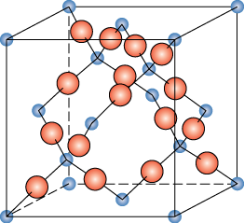
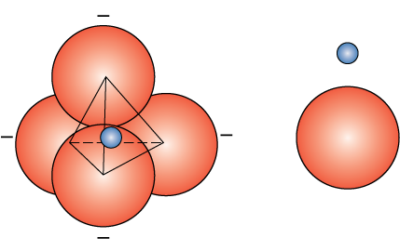
Silicate Ceramics
Most common elements on earth are Si & O
SiO₂ (silica) polymorphic forms are quartz, crystobalite, & tridymite
The strong Si-O bonds lead to a high melting temperature (1710ºC) for this material
TETRAHEDRON
Si⁴⁺
O²⁻
Adapted from Figs. 12.9-10, Callister & Rethwisch 8e
crystobalite

Slide 17
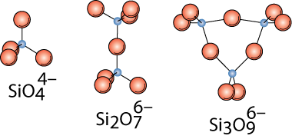

Silicates
VARIOUS COMBINATIONS
Bonding of adjacent SiO₄⁴⁻ accomplished by the sharing of common corners, edges, or faces
Adapted from Fig. 12.12, Callister & Rethwisch 8e.
Mg₂SiO₄
Ca₂MgSi₂O₇
  Presence of cations such as Ca²⁺, Mg²⁺, & Al³⁺
    1. maintain charge neutrality, and
    2. ionically bond SiO₄⁴⁻ to one another

Slide 18
Glass Structure
• Basic Unit:
Glass is noncrystalline (amorphous)
• Fused silica is SiO₂ to which no
impurities have been added
• Other common glasses contain
impurity ions such as Na⁺, Ca²⁺,
Al³⁺, and B³⁺
4-
Si0
4
tetrahedron
Si
4+
O
2
-
• Quartz is crystalline
SiO2:
Na
+
Si
4+
O
2
-
(soda glass)
Adapted from Fig. 12.11, Callister & Rethwisch 8e.

Slide 19
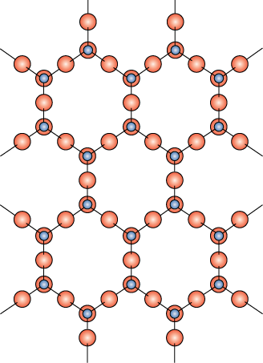
Layered Silicates
Layered silicates (e.g., clays, mica, talc)
  SiO₄ tetrahedra connected
  together to form 2-D plane
A net negative charge is associated with each (Si₂O₅)²⁻ unit
Negative charge balanced by
adjacent plane rich in positively charged cations
Adapted from Fig. 12.13, Callister & Rethwisch 8e.

Slide 20
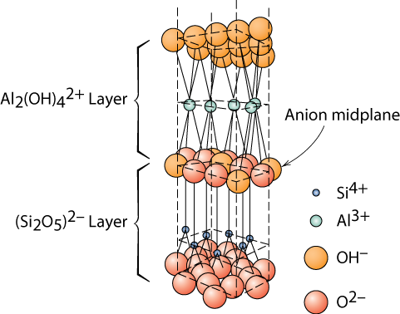
Layered Silicates (cont.)
Kaolinite clay alternates (Si₂O₅)²⁻ layer with Al₂(OH)₄²⁺ layer
Adapted from Fig. 12.14, Callister & Rethwisch 8e.
Note: Adjacent sheets of this type are loosely bound to one another by van der Waal’s forces.

Slide 21
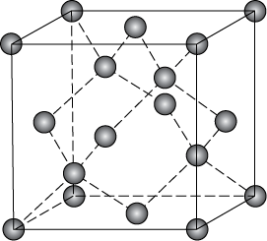
Polymorphic Forms of Carbon
Diamond
  tetrahedral bonding of carbon
    hardest material known
    very high thermal conductivity
  large single crystals – gem stones
  small crystals – used to grind/cut other materials
  diamond thin films
    hard surface coatings – used for cutting tools, medical devices, etc.
TWO DIAGONAL LINES ZnS
Adapted from Fig. 12.15, Callister & Rethwisch 8e.

Slide 22
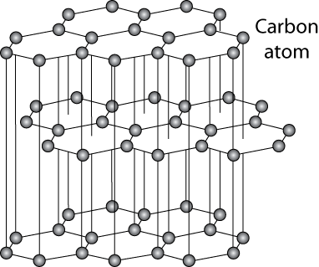
Polymorphic Forms of Carbon (cont)
Graphite
  layered structure – parallel hexagonal arrays of carbon atoms
  weak van der Waal’s forces between layers
  planes slide easily over one another -- good lubricant
BENZENE STR
DOUBLE BONDS
Adapted from Fig. 12.17, Callister & Rethwisch 8e.

Slide 23
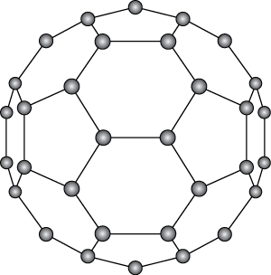
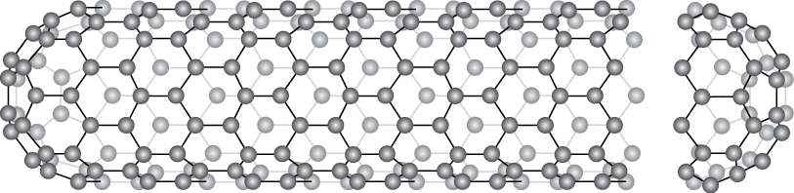
Polymorphic Forms of Carbon (cont)
Fullerenes and Nanotubes
Fullerenes – spherical cluster of 60 carbon atoms, C₆₀
  Like a soccer ball
Carbon nanotubes – sheet of graphite rolled into a tube
  Ends capped with fullerene hemispheres
Adapted from Figs. 12.18 & 12.19, Callister & Rethwisch 8e.

Slide 24
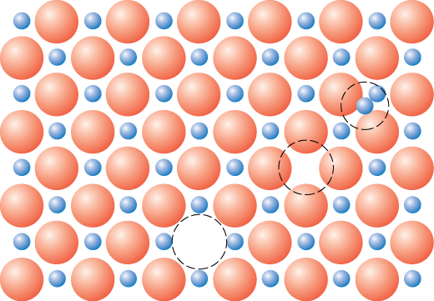
Point Defects in Ceramics (i)
• Vacancies
-- vacancies exist in ceramics for both cations and anions
• Interstitials
-- interstitials exist for cations
-- interstitials are not normally observed for anions because anions
are large relative to the interstitial sites
Cation
Interstitial
Cation
Vacancy
Adapted from Fig. 12.20, Callister & Rethwisch 8e. (Fig. 12.20 is from W.G. Moffatt, G.W. Pearsall, and J. Wulff, The Structure and Properties of Materials, Vol. 1, Structure, John Wiley and Sons, Inc., p. 78.)
Anion
Vacancy

Slide 25
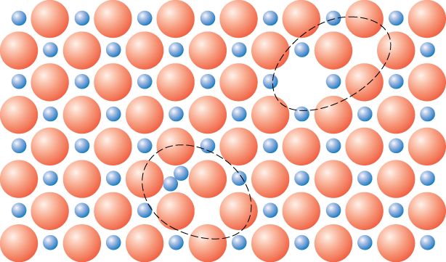
Point Defects in Ceramics (ii)
• Frenkel Defect
-- a cation vacancy-cation interstitial pair.
• Shottky Defect
-- a paired set of cation and anion vacancies.
Shottky
Defect:
Adapted from Fig.12.21, Callister & Rethwisch 8e. (Fig. 12.21 is from W.G. Moffatt, G.W. Pearsall, and J. Wulff, The Structure and Properties of Materials, Vol. 1, Structure, John Wiley and Sons, Inc., p. 78.)
Frenkel
Defect
• Equilibrium concentration of defects

Slide 26
Imperfections in Ceramics
• Electroneutrality (charge balance) must be maintained
when impurities are present
• Ex: NaCl
Na
+
Cl
-
• Substitutional cation impurity
cation
vacancy
Ca
2+
Na
+
Na
+
Ca
2+
without impurity
Ca
2+
impurity
with impurity
• Substitutional anion impurity
an
ion vacancy
O
2-
Cl
-
Cl
-
without impurity
O
2-
impurity
with impurity

Slide 27
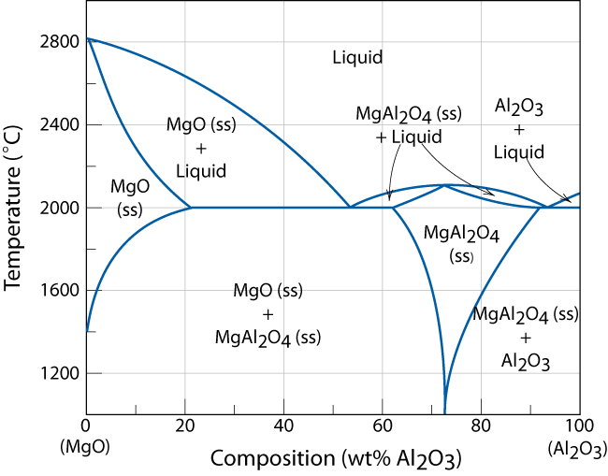
Ceramic Phase Diagrams
MgO-Al₂O₃ diagram:
°
Adapted from Fig. 12.25, Callister & Rethwisch 8e.

Slide 28
Mechanical Properties
Ceramic materials are more brittle than metals.
Why is this so?
Consider mechanism of deformation
  In crystalline, by dislocation motion
  In highly ionic solids, dislocation motion is difficult
    few slip systems
    resistance to motion of ions of like charge (e.g., anions) past one another

Slide 29
Flexural Tests – Measurement of Elastic Modulus
• Room T behavior is usually elastic, with brittle failure.
• 3-Point Bend Testing often used.
-- tensile tests are difficult for brittle materials.
F
cross section
L/2
L/2
Adapted from Fig. 12.32, Callister & Rethwisch 8e.
d
R
b
δ = midpoint
rect.
circ.
deflection
• Determine elastic modulus according to:
F
x
(rect. cross section)
F
slope =
δ
(circ. cross section)
δ
linear-elastic behavior

Slide 30
Flexural Tests – Measurement of Flexural Strength
• 3-point bend test to measure room-T flexural strength.
F
cross section
L/2
L/2
Adapted from Fig. 12.32, Callister & Rethwisch 8e.
d
R
b
δ = midpoint
rect.
circ.
deflection
location of max tension
• Flexural strength:
• Typical values:
Material
σ
fs
(MPa) E(GPa)
(rect. cross section)
Si nitride
Si carbide
Al oxide
glass (soda-lime)
250-1000
100-820
275-700
69
304
345
393
69
(circ. cross section)
Data from Table 12.5, Callister & Rethwisch 8e.

Slide 31
SUMMARY
• Interatomic bonding in ceramics is ionic and/or covalent.
• Ceramic crystal structures are based on:
-- maintaining charge neutrality
-- cation-anion radii ratios.
• Imperfections
-- Atomic point: vacancy, interstitial (cation), Frenkel, Schottky
-- Impurities: substitutional, interstitial
-- Maintenance of charge neutrality
• Room-temperature mechanical behavior – flexural tests
-- linear-elastic; measurement of elastic modulus
-- brittle fracture; measurement of flexural modulus

Slide 32
ANNOUNCEMENTS
Reading:
Core Problems:
Self-help Problems:

