Slide 1
Chapter 14:
Polymer Structures
ISSUES TO ADDRESS...
• What are the general structural and chemical
characteristics of polymer molecules?
• What are some of the common polymeric
materials, and how do they differ chemically?
• How is the crystalline state in polymers different
from that in metals and ceramics ?

Slide 2
What is a Polymer?
Poly mer
        many repeat unit
repeat
unit
repeat
unit
repeat
unit
H
H
H
H
H
H
H
H
H
H
H
H
H
H
H
H
H
H
C
C
C
C
C
C
C
C
C
C
C
C
C
C
C
C
C
C
H
H
H
H
H
H
H
Cl
H
Cl
H
Cl
H
CH₃
H
CH₃
H
CH₃
Polyethylene (PE)
Poly(vinyl chloride) (PVC)
Polypropylene (PP)
Adapted from Fig. 14.2, Callister & Rethwisch 8e.

Slide 3
Ancient Polymers
Originally natural polymers were used
  Wood – Rubber
  Cotton – Wool
  Leather – Silk
Oldest known uses
  Rubber balls used by Incas
  Noah used pitch (a natural polymer)
  for the ark

Slide 4
Polymer Composition
Most polymers are hydrocarbons
– i.e., made up of H and C
Saturated hydrocarbons
  Each carbon singly bonded to four other atoms
  Example:
    Ethane, C₂H₆

Slide 6
Unsaturated Hydrocarbons
Double & triple bonds somewhat unstable – can form new bonds
  Double bond found in ethylene or ethene - C₂H₄
  Triple bond found in acetylene or ethyne - C₂H₂

Slide 7
Isomerism
Isomerism
  two compounds with same chemical formula can have quite different structures
  for example: C₈H₁₈
    normal-octane
    2,4-dimethylhexane
⇓

Slide 8
Polymerization and
Polymer Chemistry
Free radical polymerization
Initiator: example - benzoyl peroxide

Slide 9
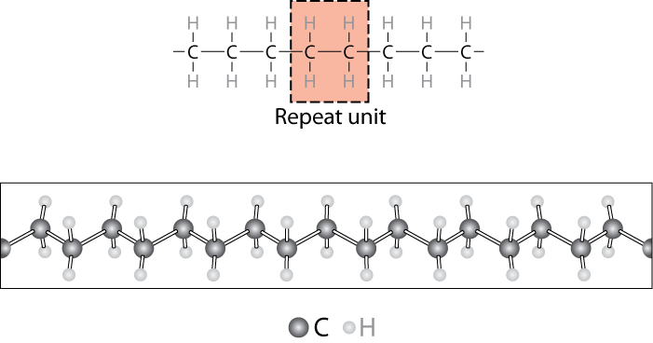
Chemistry and Structure of Polyethylene
Adapted from Fig. 14.1, Callister & Rethwisch 8e.
Note: polyethylene is a long-chain hydrocarbon
- paraffin wax for candles is short polyethylene
Notes:
Polymer- can have various lengths depending on number of repeat units

Slide 10
Bulk or Commodity Polymers
Notes:
Relatively few polymers responsible for virtually all polymers sold – these are the bulk or commodity polymers

Slide 11
Bulk or Commodity Polymers (cont)

Slide 12
Bulk or Commodity Polymers (cont)

Slide 13
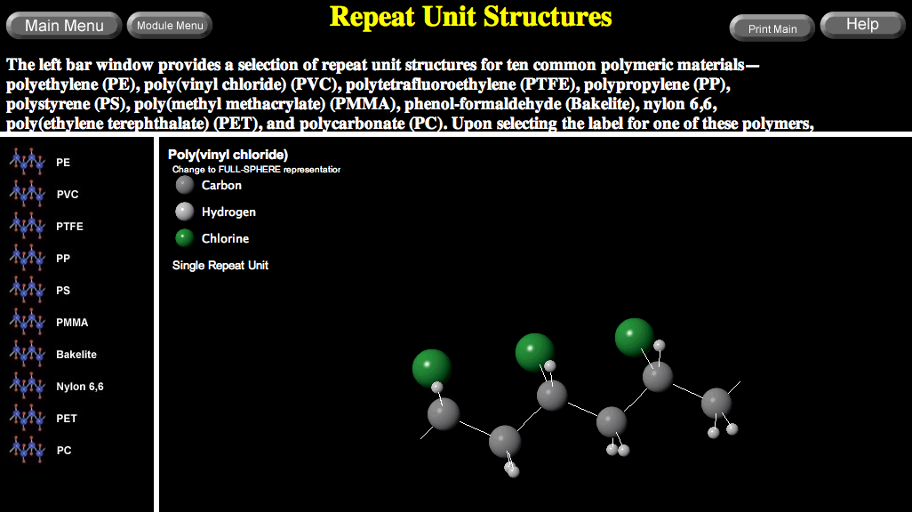
VMSE: Polymer Repeat Unit Structures
Manipulate and rotate polymer structures in 3-dimensions

Slide 14
MOLECULAR WEIGHT
• Molecular weight, M: Mass of a mole of chains.
Low M
high M
Not all chains in a polymer are of the same length
— i.e., there is a distribution of molecular weights
Notes:
Simple for small molecules
All the same size
Number of grams/mole
Polymers – distribution of chain sizes

Slide 15
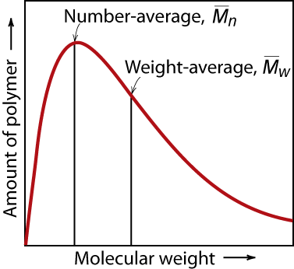
MOLECULAR WEIGHT DISTRIBUTION
Adapted from Fig. 14.4, Callister & Rethwisch 8e.
M_{i} = mean (middle) molecular weight of size range i
x_{i} = number fraction of chains in size range i
w_{i} = weight fraction of chains in size range i
Notes:
Simple for small molecules
All the same size
Number of grams/mole
Polymers – distribution of chain sizes

Slide 16
Molecular Weight Calculation
Example: average mass of a class
Student | Weight
 | mass (lb)
1 | 104
2 | 116
3 | 140
4 | 143
5 | 180
6 | 182
7 | 191
8 | 220
9 | 225
10 | 380
What is the average
weight of the students in
this class:
Based on the number fraction of students in each mass range?
Based on the weight fraction of students in each mass range?

Slide 17
Molecular Weight Calculation (cont.)
Solution: The first step is to sort the students into weight ranges. Using 40 lb ranges gives the following table:
Calculate the number and weight fraction of students in each weight range as follows:
For example: for the 81-120 lb range
total
number
total
weight

Slide 18
Molecular Weight Calculation (cont.)

Slide 19
Degree of Polymerization, DP
DP = average number of repeat units per chain
DP = 6
Chain fraction
mol. wt of repeat unit i

Slide 20
Molecular Structures for Polymers
secondary
bonding
Linear
B
ranched
Cross-Linked
Network
Adapted from Fig. 14.7, Callister & Rethwisch 8e.

Slide 21
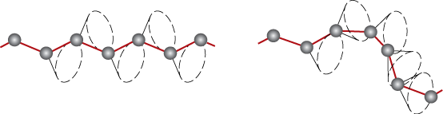
Polymers – Molecular Shape
Molecular Shape (or Conformation) – chain bending and twisting are possible by rotation of carbon atoms around their chain bonds
  note: not necessary to break chain bonds to alter molecular shape
Adapted from Fig. 14.5, Callister & Rethwisch 8e.

Slide 22
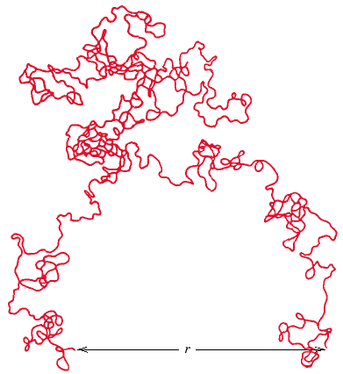
Chain End-to-End Distance, r
Adapted from Fig. 14.6, Callister & Rethwisch 8e.

Slide 23
Molecular Configurations for Polymers
Configurations – to change must break bonds
Stereoisomerism
A
A
Stereoisomers are mirror
images – can’t superimpose
without breaking a bond
C
C
E
E
B
D
D
B
mirror plane

Slide 24
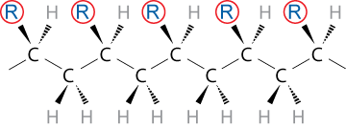
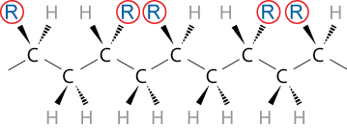
Tacticity
Tacticity – stereoregularity or spatial arrangement of R units along chain
isotactic – all R groups on same side of chain
syndiotactic – R groups alternate sides

Slide 25
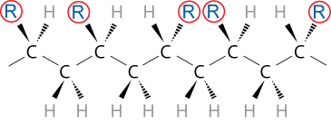
Tacticity (cont.)
atactic – R groups randomly
positioned

Slide 26
cis/trans Isomerism
cis
cis-isoprene
(natural rubber)
H atom and CH₃ group on same side of chain
trans
trans-isoprene
(gutta percha)
H atom and CH₃ group on opposite sides of chain

Slide 27
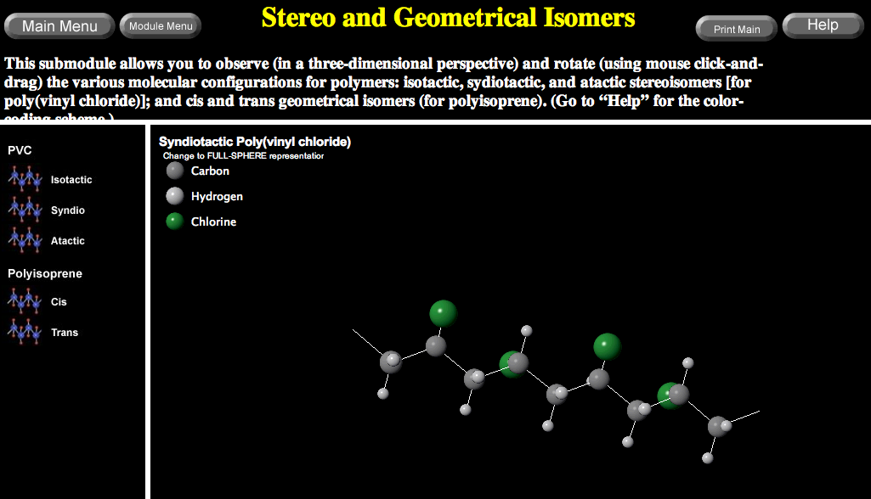
VMSE: Stereo and Geometrical Isomers
Manipulate and rotate polymer structures in 3-dimensions
Chapter 7 - 19

Slide 28
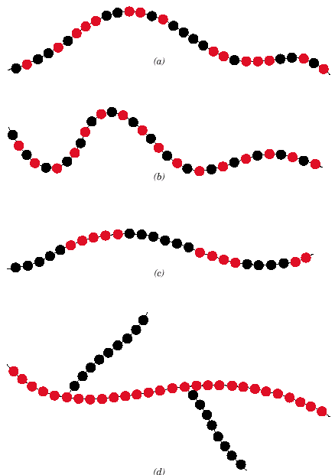
Copolymers
Adapted from Fig. 14.9, Callister & Rethwisch 8e.
two or more monomers polymerized together
random – A and B randomly positioned along chain
alternating – A and B alternate in polymer chain
block – large blocks of A units alternate with large blocks of B units
graft – chains of B units grafted onto A backbone
  A – B –
random
alternating
block
graft

Slide 29
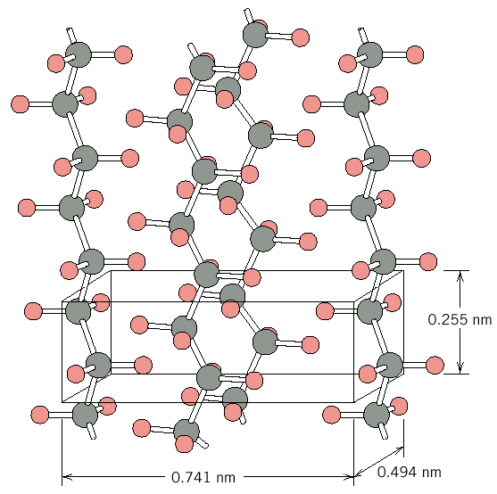
Crystallinity in Polymers
Adapted from Fig. 14.10, Callister & Rethwisch 8e.
Ordered atomic arrangements involving molecular chains
Crystal structures in terms of unit cells
Example shown
  polyethylene unit cell

Slide 30
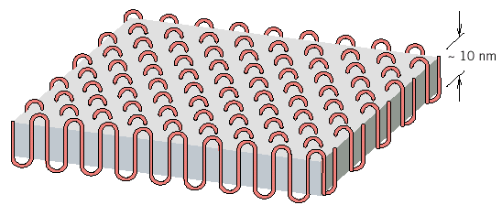
Polymer Crystallinity
Crystalline regions
  thin platelets with chain folds at faces
  Chain folded structure
Adapted from Fig. 14.12, Callister & Rethwisch 8e.
10 nm

Slide 31
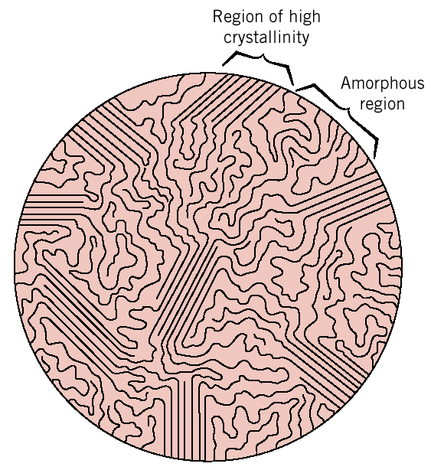
Polymer Crystallinity (cont.)
Polymers rarely 100% crystalline
Difficult for all regions of all chains to become aligned
crystalline
region
• Degree of crystallinity
expressed as % crystallinity.
-- Some physical properties
depend on % crystallinity.
-- Heat treating causes
crystalline regions to grow
and % crystallinity to
increase.
amorphous
region
Adapted from Fig. 14.11, Callister 6e.
(Fig. 14.11 is from H.W. Hayden, W.G. Moffatt,
and J. Wulff, The Structure and Properties of Materials, Vol. III, Mechanical Behavior, John Wiley and Sons, Inc., 1965.)

Slide 32
Polymer Single Crystals
Electron micrograph – multilayered single crystals (chain-folded layers) of polyethylene
Single crystals – only for slow and carefully controlled growth rates
Adapted from Fig. 14.11, Callister & Rethwisch 8e.

Slide 33
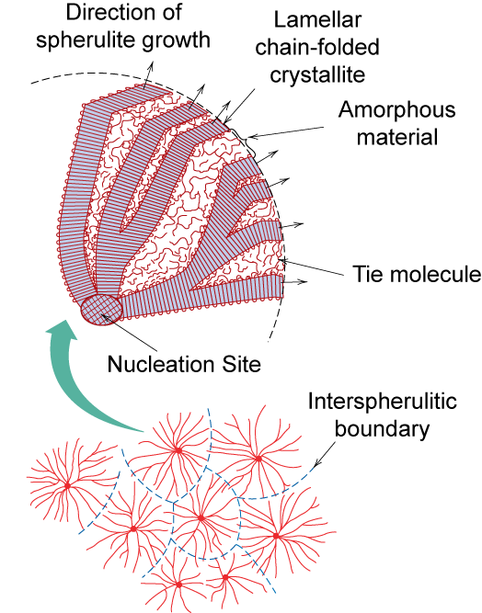
Semicrystalline Polymers
Some semicrystalline polymers form spherulite structures
Alternating chain-folded crystallites and amorphous regions
Spherulite structure for relatively rapid growth rates
Spherulite surface
Adapted from Fig. 14.13, Callister & Rethwisch 8e.

Slide 34
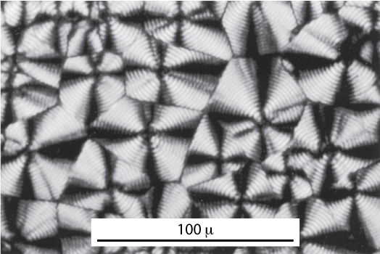
Photomicrograph – Spherulites in Polyethylene
Cross-polarized light used
-- a maltese cross appears in each spherulite
Adapted from Fig. 14.14, Callister & Rethwisch 8e.

Slide 35
ANNOUNCEMENTS
Reading:
Core Problems:
Self-help Problems:

