Slide 1
Chapter 18: Electrical Properties
ISSUES TO ADDRESS...
• How are electrical conductance and resistance
characterized?
• What are the physical phenomena that distinguish
conductors, semiconductors, and insulators?
• For metals, how is conductivity affected by
imperfections, temperature, and deformation?
• For semiconductors, how is conductivity affected
by impurities (doping) and temperature?

Slide 2
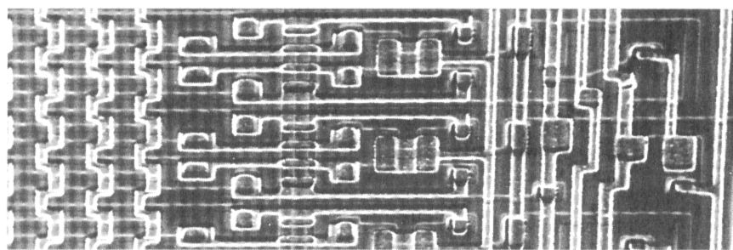
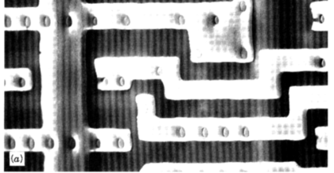
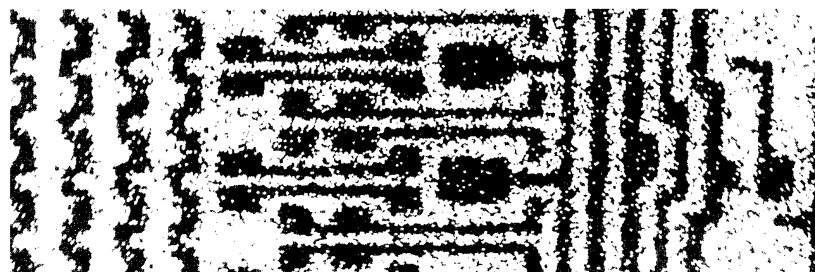
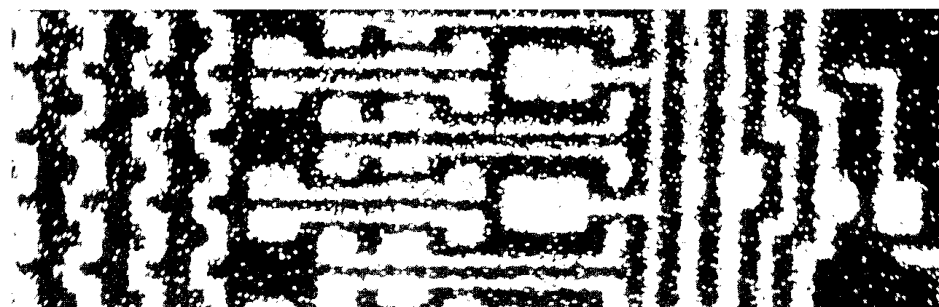
View of an Integrated Circuit
• Scanning electron micrographs of an IC:
Al
(d)
(d)
(a)
Si
(doped)
45 μm
0.5 mm
• A dot map showing location of Si (a semiconductor):
-- Si shows up as light regions.
(b)
• A dot map showing location of Al (a conductor):
-- Al shows up as light regions.
(c)
Fig. (d) from Fig. 12.27(a), Callister & Rethwisch 3e.
(Fig. 12.27 is courtesy Nick Gonzales, National Semiconductor Corp., West Jordan, UT.)
Figs. (a), (b), (c) from Fig. 18.27, Callister & Rethwisch 8e.

Slide 3
Electrical Conduction
• Ohm's Law:
V = I R
voltage drop (volts = J/C)
C = Coulomb
resistance (Ohms)
current (amps = C/s)
• Resistivity, ρ:
-- a material property that is independent of sample size and
geometry
surface area
of current flow
current flow
path length
• Conductivity, σ

Slide 4
Electrical Properties
Which will have the greater resistance?
Analogous to flow of water in a pipe
Resistance depends on sample geometry and size.
2
D
2D

Slide 5
Definitions
Further definitions
  J = σ ε <= another way to state Ohm’s law
  J ≡ current density
  ε ≡ electric field potential = V/
J = σ (V/ )
Electron flux conductivity voltage gradient

Slide 6
Conductivity: Comparison
• Room temperature values (Ohm-m)⁻¹ = (Ω - m)⁻¹
METALS
conductors
CERAMICS
Silver
6.8 x 10
7
Soda-lime glass 10
-10
-10
-11
Copper
6.0 x 10
7
Concrete 10
-9
Iron
1.0 x 10
7
Aluminum oxide <10
-13
SEMICONDUCTORS
POLYMERS
-4
Polystyrene <10
-14
Silicon
4 x 10
Germanium
2 x 10
0
Polyethylene 10
-15
-10
-17
GaAs
10
-6
semiconductors
insulators
Selected values from Tables 18.1, 18.3, and 18.4, Callister & Rethwisch 8e.

Slide 7
Example: Conductivity Problem
What is the minimum diameter (D) of the wire so that V < 1.5 V?
Cu wire
-
I = 2.5 A
+
V
100 m
< 1.5 V
2.5 A
6.07 x 10⁷ (Ohm-m)⁻¹
Solve to get D > 1.87 mm

Slide 8
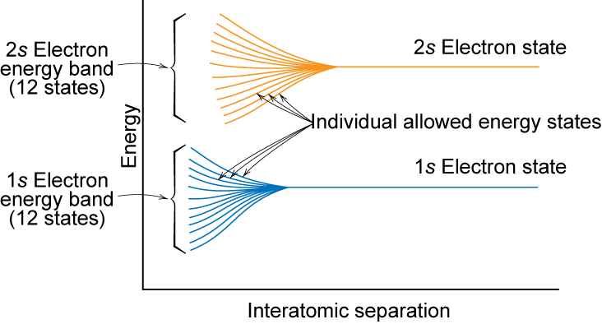
Electron Energy Band Structures
Adapted from Fig. 18.2, Callister & Rethwisch 8e.
Notes:
So the individual atomic energy levels interact to form molecular energy levels

Slide 9
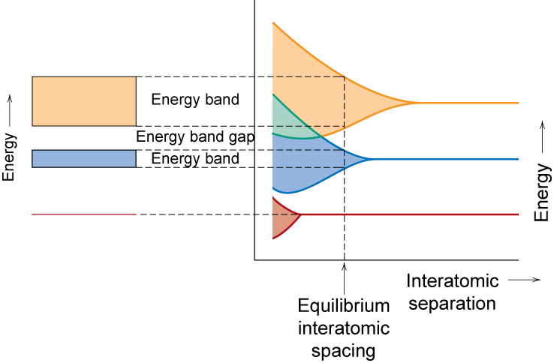
Band Structure Representation
Adapted from Fig. 18.3, Callister & Rethwisch 8e.
Notes:
contains valence electrons from the atoms

Slide 10
Conduction & Electron Transport
• Metals (Conductors):
-- for metals empty energy states are adjacent to filled states.
-- thermal energy
excites electrons
into empty higher
energy states.
Partially filled band
Overlapping bands
Energy
Energy
empty
band
-- two types of band
structures for metals
GAP
empty
band
- partially filled band
partly
- empty band that
overlaps filled band
filled
filled
band
band
filled states
filled states
filled
filled
band
band

Slide 11
Energy Band Structures: Insulators & Semiconductors
• Insulators:
-- wide band gap (> 2 eV)
-- few electrons excited
across band gap
• Semiconductors:
-- narrow band gap (< 2 eV)
-- more electrons excited
across band gap
Energy
empty
Energy
empty
conduction
conduction
band
band
GAP
?
GAP
filled
filled
valence
valence
band
band
filled states
filled states
filled
filled
band
band

Slide 12
Metals: Influence of Temperature and Impurities on Resistivity
• Presence of imperfections increases resistivity
-- grain boundaries
-- dislocations
-- impurity atoms
-- vacancies
These act to scatter
electrons so that they
take a less direct path.
6
ρ
Cu + 3.32 at%Ni
• Resistivity
increases with:
5
Ohm-m)
4
deformed Cu + 1.12 at%Ni
-- temperature
Resistivity,
3
Cu + 1.12 at%Ni
-- wt% impurity
-8
ρ_{d}
-- %CW
(10
2
ρ_{i}
ρ =
1
“Pure” Cu
ρ_{thermal}
ρ_{t}
+ ρ_{impurity}
0
-200
-100
0
T (ºC)
+ ρ_{deformation}
Adapted from Fig. 18.8, Callister & Rethwisch 8e. (Fig. 18.8 adapted from J.O. Linde, Ann. Physik 5, p. 219 (1932); and C.A. Wert and R.M. Thomson, Physics of Solids, 2nd ed., McGraw-Hill Book Company, New York, 1970.)

Slide 13
Estimating Conductivity
• Question:
-- Estimate the electrical conductivity σ of a Cu-Ni alloy
that has a yield strength of 125 MPa.
Adapted from Fig. 18.9, Callister & Rethwisch 8e.
180
ρ
50
160
Ohm-m)
140
40
125
30
120
Resistivity,
30
Yield strength (MPa)
-8
100
20
21 wt% Ni
(10
80
10
60
0
0
10
20
30
40
50
0
10
20
30
40
50
wt% Ni, (Concentration C)
wt% Ni, (Concentration C)
Adapted from Fig. 7.16(b), Callister & Rethwisch 8e.
From step 1:
C_{Ni} = 21 wt% Ni

Slide 14
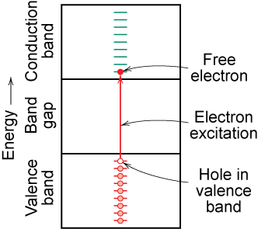
Charge Carriers in Insulators and Semiconductors
Adapted from Fig. 18.6(b), Callister & Rethwisch 8e.
Two types of electronic charge carriers:
Free Electron
– negative charge
– in conduction band
Hole
– positive charge
– vacant electron state in
the valence band
Move at different speeds - drift velocities

Slide 15
Intrinsic Semiconductors
Pure material semiconductors: e.g., silicon & germanium
  Group IVA materials
Compound semiconductors
  III-V compounds
    Ex: GaAs & InSb
  II-VI compounds
    Ex: CdS & ZnTe
  The wider the electronegativity difference between
  the elements the wider the energy gap.

Slide 16
Intrinsic Semiconduction in Terms of Electron and Hole Migration
• Concept of electrons and holes:
valence
electron
hole
electron
hole
electron
Si atom
pair creation
pair migration
-
+
-
+
no applied
applied
applied
electric field
electric field
electric field
• Electrical Conductivity given by:
Adapted from Fig. 18.11, Callister & Rethwisch 8e.
# holes/m³
hole mobility
# electrons/m³
electron mobility

Slide 17
Number of Charge Carriers
Intrinsic Conductivity
for intrinsic semiconductor n = p = n_{i}
∴
σ = n_{i}|e|(μ_{e} + μ_{h})
Ex: GaAs
For GaAs n_{i} = 4.8 x 10²⁴ m⁻³
For Si n_{i} = 1.3 x 10¹⁶ m⁻³

Slide 18
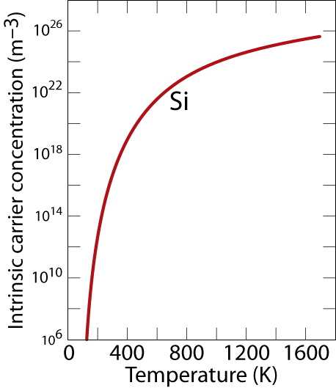
Intrinsic Semiconductors:
Conductivity vs T
• Data for Pure Silicon:
-- σ increases with T
-- opposite to metals
material
Si
Ge
GaP
CdS
band gap (eV)
1.11
0.67
2.25
2.40
Selected values from Table 18.3, Callister & Rethwisch 8e.
Adapted from Fig. 18.16, Callister & Rethwisch 8e.

Slide 19
Intrinsic vs Extrinsic Conduction
• Intrinsic:
-- case for pure Si
-- # electrons = # holes (n = p)
• Extrinsic:
-- electrical behavior is determined by presence of impurities
that introduce excess electrons or holes
-- n ≠ p
• n-type Extrinsic: (n >> p)
• p-type Extrinsic: (p >> n)
Phosphorus atom
Boron atom
hole
4
+
4
+
4
+
4
+
conduction
4
+
4
+
4
+
4
+
electron
4
+
5+
4
+
4
+
4
+
3
+
4
+
4
+
valence
4
+
4
+
4
+
4
+
electron
4
+
4
+
4
+
4
+
no applied
Si atom
no applied
Adapted from Figs. 18.12(a) & 18.14(a), Callister & Rethwisch 8e.
electric field
electric field

Slide 20
Extrinsic Semiconductors: Conductivity vs. Temperature
• Data for Doped Silicon:
-- σ increases doping
-- reason: imperfection sites
lower the activation energy to
produce mobile electrons.
doped
undoped
3
2
• Comparison: intrinsic vs
extrinsic conduction...
-- extrinsic doping level:
10²¹/m³ of a n-type donor
impurity (such as P).
-- for T < 100 K: "freeze-out“,
thermal energy insufficient to
excite electrons.
-- for 150 K < T < 450 K: "extrinsic"
-- for T >> 450 K: "intrinsic"
freeze-out
extrinsic
intrinsic
concentration (10²¹/m³)
Conduction electron
1
0
0
200
400
600
T
(K)
Adapted from Fig. 18.17, Callister & Rethwisch 8e. (Fig. 18.17 from S.M. Sze, Semiconductor Devices, Physics, and Technology, Bell Telephone Laboratories, Inc., 1985.)

Slide 21
p-n Rectifying Junction
• Allows flow of electrons in one direction only (e.g., useful
to convert alternating current to direct current).
• Processing: diffuse P into one side of a B-doped crystal.
+
p-type
-
n-type
-- No applied potential:
no net current flow.
+
+
-
Adapted from Fig. 18.21 Callister & Rethwisch 8e.
+
+
-
-
-
-- Forward bias: carriers
flow through p-type and
n-type regions; holes and
electrons recombine at
p-n junction; current flows.
p-type
+
-
n-type
+
+
+
-
+
-
-
-
+
-
-- Reverse bias: carriers
flow away from p-n junction;
junction region depleted of
carriers; little current flow.
p-type
n-type
-
+
+
-
+
-
-
+
+
+
-
-

Slide 22
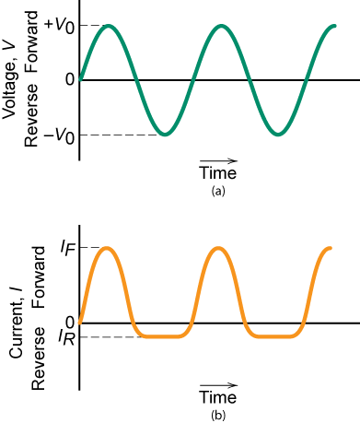
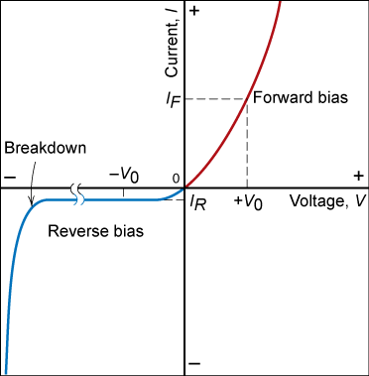
Properties of Rectifying Junction
Fig. 18.22, Callister & Rethwisch 8e.
Fig. 18.23, Callister & Rethwisch 8e.

Slide 23
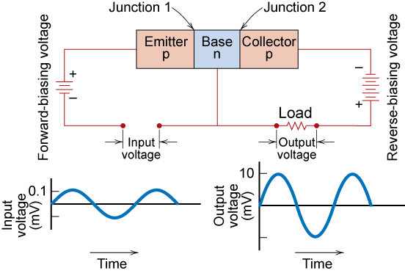
Junction Transistor
Fig. 18.24, Callister & Rethwisch 8e.

Slide 24
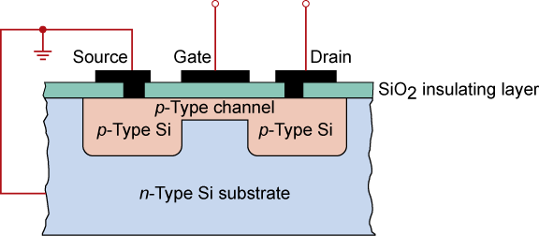
MOSFET Transistor
Integrated Circuit Device
Fig. 18.26, Callister & Rethwisch 8e.
MOSFET (metal oxide semiconductor field effect transistor)
Integrated circuits - state of the art ca. 50 nm line width
  ~ 1,000,000,000 components on chip
  chips formed one layer at a time

Slide 25
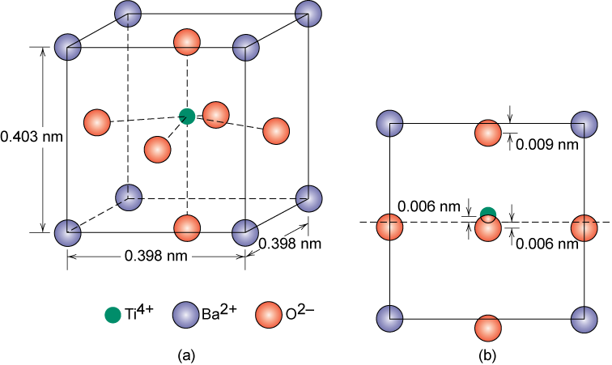
Ferroelectric Ceramics
Experience spontaneous polarization
BaTiO₃ -- ferroelectric below its Curie temperature (120ºC)
Fig. 18.35, Callister & Rethwisch 8e.

Slide 26
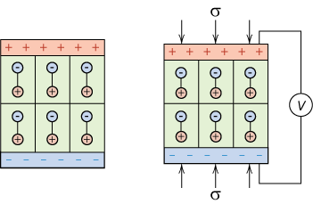
Piezoelectric Materials
Piezoelectricity
– application of stress induces voltage
– application of voltage induces dimensional change
stress-free
with applied stress
Adapted from Fig. 18.36, Callister & Rethwisch 8e. (Fig. 18.36 from Van Vlack, Lawrence H., Elements of Materials Science and Engineering, 1989, p.482, Adapted by permission of Pearson Education, Inc., Upper Saddle River, New Jersey.)

Slide 27
Summary
• Electrical conductivity and resistivity are:
-- material parameters
-- geometry independent
• Conductors, semiconductors, and insulators...
-- differ in range of conductivity values
-- differ in availability of electron excitation states
• For metals, resistivity is increased by
-- increasing temperature
-- addition of imperfections
-- plastic deformation
• For pure semiconductors, conductivity is increased by
-- increasing temperature
-- doping [e.g., adding B to Si (p-type) or P to Si (n-type)]
• Other electrical characteristics
-- ferroelectricity
-- piezoelectricity

Slide 28
ANNOUNCEMENTS
Reading:
Core Problems:
Self-help Problems:

