Slide 1
Chapter 19:
Thermal Properties
ISSUES TO ADDRESS...
• How do materials respond to the application of heat?
• How do we define and measure...
-- heat capacity?
-- thermal expansion?
-- thermal conductivity?
-- thermal shock resistance?
• How do the thermal properties of ceramics, metals,
and polymers differ?

Slide 2
Heat Capacity
The ability of a material to absorb heat
• Quantitatively: The energy required to produce a unit rise in
temperature for one mole of a material.
energy input (J/mol)
heat capacity
(J/mol-K)
temperature change (K)
• Two ways to measure heat capacity:
C_{p} : Heat capacity at constant pressure.
C_{v} : Heat capacity at constant volume.
C_{p} usually > C_{v}
• Heat capacity has units of

Slide 3

Dependence of Heat Capacity on Temperature
• Heat capacity...
-- increases with temperature
-- for solids it reaches a limiting value of 3R
R = gas constant
3R
C_{v} = constant
= 8.31 J/mol-K
C_{v}
Adapted from Fig. 19.2, Callister & Rethwisch 8e.
0
T (K)
0
θ
D
Debye temperature
(usually less than T
room
)
• From atomic perspective:
-- Energy is stored as atomic vibrations.
-- As temperature increases, the average energy of
atomic vibrations increases.

Slide 4
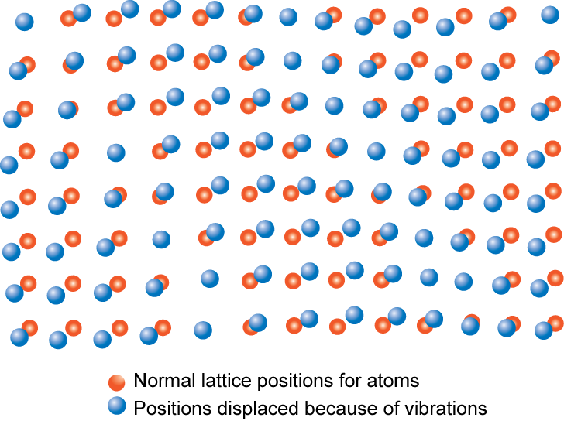
Atomic Vibrations
Atomic vibrations are in the form of lattice waves or phonons
Adapted from Fig. 19.1, Callister & Rethwisch 8e.

Slide 5
Specific Heat: Comparison
Material
c_{p} (J/kg-K)
at room T
• Polymers
Polypropylene
1925
c_{p} (specific heat): (J/kg-K)
Polyethylene
1850
C_{p} (heat capacity): (J/mol-K)
Polystyrene
1170
Teflon
1050
• Why is c_{p} significantly
larger for polymers?
• Ceramics
Magnesia (MgO)
940
increasing c_{p}
Alumina (Al₂O₃)
775
Glass
840
• Metals
Aluminum
900
Steel
486
Tungsten
138
Selected values from Table 19.1, Callister & Rethwisch 8e.
Gold
128

Slide 6
Thermal Expansion
Materials change size when temperature
is changed
T_{initial}
● _{initial}
T_{final} > T_{initial}
T_{final}
● _{final}
linear coefficient of
thermal expansion (1/K or 1/ºC)

Slide 7
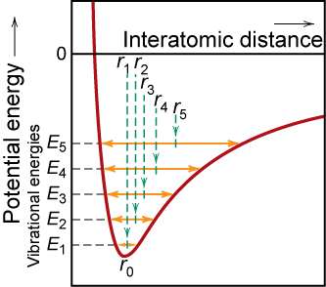
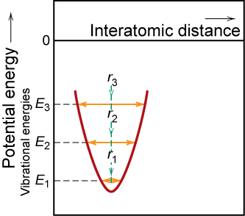
Atomic Perspective: Thermal Expansion
Asymmetric curve:
-- increase temperature,
-- increase in interatomic
separation
-- thermal expansion
Symmetric curve:
-- increase temperature,
-- no increase in interatomic
separation
-- no thermal expansion
Adapted from Fig. 19.3, Callister & Rethwisch 8e.

Slide 8
Coefficient of Thermal Expansion: Comparison
Material
α (10⁻⁶/°C)
at room T
• Polymers
Polypropylene
145-180
Polymers have larger α values because of weak secondary bonds
Polyethylene
106-198
Polystyrene
90-150
Teflon
126-216
• Metals
• Q: Why does α
generally decrease
with increasing
bond energy?
Aluminum
23.6
increasing α
Steel
12
Tungsten
4.5
Gold
14.2
• Ceramics
Magnesia (MgO)
13.5
Alumina (Al₂O₃)
7.6
Selected values from Table 19.1, Callister & Rethwisch 8e.
Soda-lime glass
9
Silica (cryst. SiO₂)
0.4

Slide 9
Thermal Expansion: Example
Ex: A copper wire 15 m long is cooled from
40 to -9ºC. How much change in length will it experience?
Answer: For Cu
rearranging Equation 19.3b

Slide 10
Thermal Conductivity
The ability of a material to transport heat.
Fourier’s Law
temperature
gradient
heat flux
(J/m²-s)
thermal conductivity (J/m-K-s)
T₁
T₂
T₂ > T₁
x₁
heat flux
x₂
• Atomic perspective: Atomic vibrations and free electrons in
hotter regions transport energy to cooler regions.

Slide 11
Thermal Conductivity: Comparison
Energy Transfer
Mechanism
Material
k (W/m-K)
• Metals
Aluminum
247
atomic vibrations and motion of free electrons
Steel
52
Tungsten
178
Gold
315
• Ceramics
Magnesia (MgO)
38
Alumina (Al₂O₃)
39
atomic vibrations
increasing k
Soda-lime glass
1.7
Silica (cryst. SiO₂)
1.4
• Polymers
Polypropylene
0.12
Polyethylene
0.46-0.50
vibration/rotation of chain molecules
Polystyrene
0.13
Teflon
0.25
Selected values from Table 19.1, Callister & Rethwisch 8e.

Slide 12
Thermal Stresses
• Occur due to:
-- restrained thermal expansion/contraction
-- temperature gradients that lead to differential
dimensional changes
Thermal stress
= σ

Slide 13
Example Problem
-- A brass rod is stress-free at room temperature (20ºC).
-- It is heated up, but prevented from lengthening.
-- At what temperature does the stress reach -172 MPa?
Solution:
T₀
Original conditions
● ₀
Step 1: Assume unconstrained thermal expansion
● ₀
Δ
T_{f}
Step 2: Compress specimen back to original length
● ₀
Δ
σ
σ
Notes:
13

Slide 14
Example Problem (cont.)
● ₀
The thermal stress can be directly calculated as
σ
σ
Noting that ε_{compress} = -ε_{thermal} and substituting gives
Rearranging and solving for T_{f} gives
20ºC
-172 MPa (since in compression)
Answer: 106ºC
100 GPa
20 x 10⁻⁶/ºC
14
Notes:
14

Slide 15
Thermal Shock Resistance
• Occurs due to: nonuniform heating/cooling
• Ex: Assume top thin layer is rapidly cooled from T₁ to T₂
rapid quench
σ
T₂
Tension develops at surface
tries to contract during cooling
resists contraction
T₁
Temperature difference that
can be produced by cooling:
Critical temperature difference
for fracture (set σ = σ_{f})
set equal
•
• Large TSR when is large

Slide 16
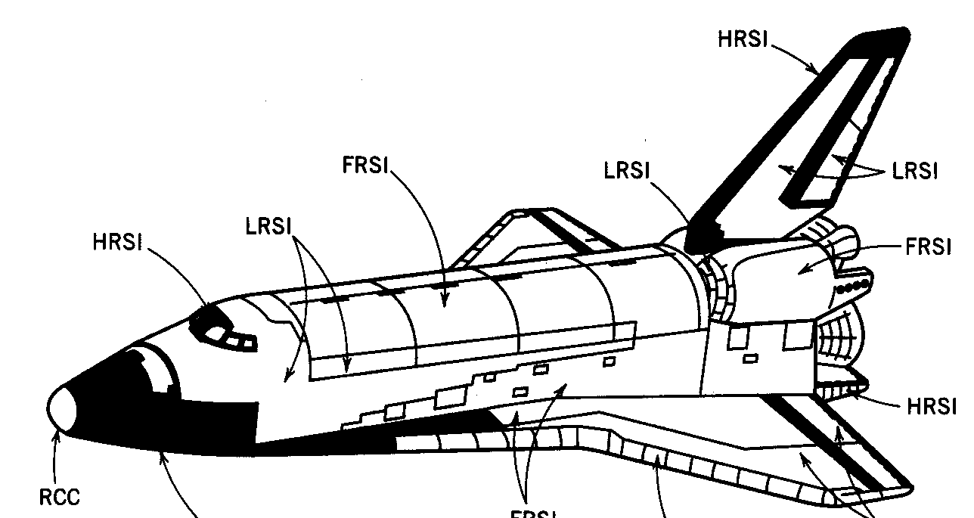
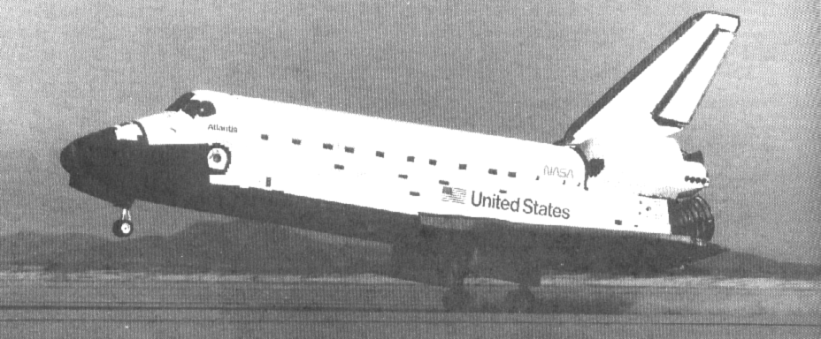
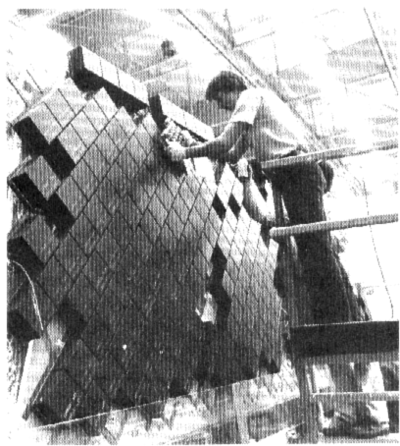
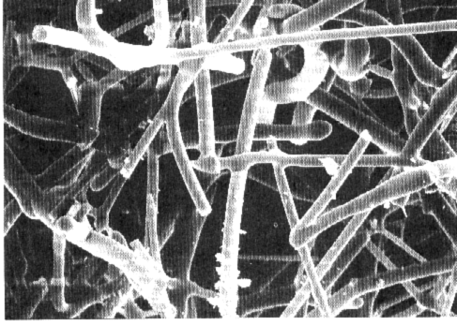
Thermal Protection System
Re-entry T
• Application:
Distribution
Space Shuttle Orbiter
reinf C-C
silica tiles
nylon felt, silicon rubber
Chapter-opening photograph, Chapter 23, Callister 5e (courtesy of the National Aeronautics and Space Administration.)
(1650ºC)
(400-1260ºC)
coating (400ºC)
Fig. 19.2W, Callister 6e. (Fig. 19.2W adapted from L.J. Korb, C.A. Morant, R.M. Calland, and C.S. Thatcher, "The Shuttle Orbiter Thermal Protection System", Ceramic Bulletin, No. 11, Nov. 1981, p. 1189.)
• Silica tiles (400-1260ºC):
-- large scale application
-- microstructure:
~90% porosity!
Si fibers
bonded to one
another during
heat treatment.
100 μm
Fig. 19.3W, Callister 5e. (Fig. 19.3W courtesy the National Aeronautics and Space Administration.)
Fig. 19.4W, Callister 5e. (Fig. 219.4W courtesy Lockheed Aerospace Ceramics
Systems, Sunnyvale, CA.)

Slide 17
THERMAL DIFFUSIVITY
It measures the ability of a material to conduct thermal energy relative to its ability to store thermal energy.It has the SI unit of m²/s. Thermal diffusivity is usually denoted by α
The formula is:
α = k/(c x rho )
where
k is thermal conductivity (W/(m·K))
rho is density (kg/m³)
c is specific heat capacity (J/(kg·K))

Slide 18
Summary
The thermal properties of materials include:
• Heat capacity:
-- energy required to increase a mole of material by a unit T
-- energy is stored as atomic vibrations
• Coefficient of thermal expansion:
-- the size of a material changes with a change in temperature
-- polymers have the largest values
• Thermal conductivity:
-- the ability of a material to transport heat
-- metals have the largest values
• Thermal shock resistance:
-- the ability of a material to be rapidly cooled and not fracture
-- is proportional to

Slide 19
ANNOUNCEMENTS
Reading:
Core Problems:
Self-help Problems:

