Slide 1
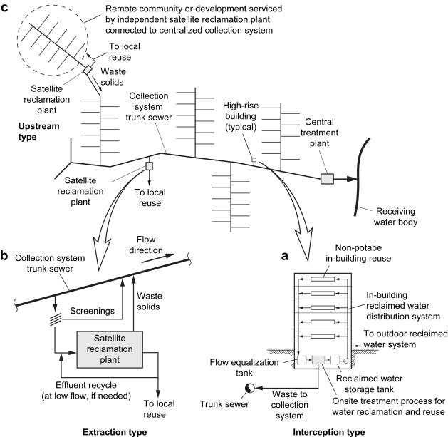
Schematic illustration of three types of satellite water reclamation and reuse systems:
(a) interception type,
(b) extraction type, and
(c) upstream type
(adapted from Asano et al., 2007).
Gikas, P., Tchobanoglous, G.,
2009, The role of satellite and
decentralized strategies in
water resources Management,
Journal of Environmental
Management, 90:133-152

Slide 2
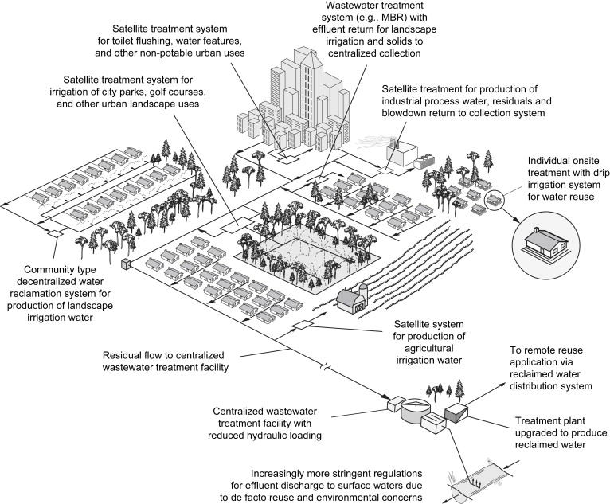
Interception, Reuse
Upstream,
Reclamation
Extraction,
Wastewater
Mining
Extraction, Wastewater Mining
Illustration of the applications
for satellite and decentralized
reclamation facilities in densely
populated areas (adapted from
Asano et al., 2007).
Gikas, P., Tchobanoglous, G., 2009, The role of satellite and decentralized strategies
In water resources Management, Journal of Environmental Management, 90:133-152

