Slide 1
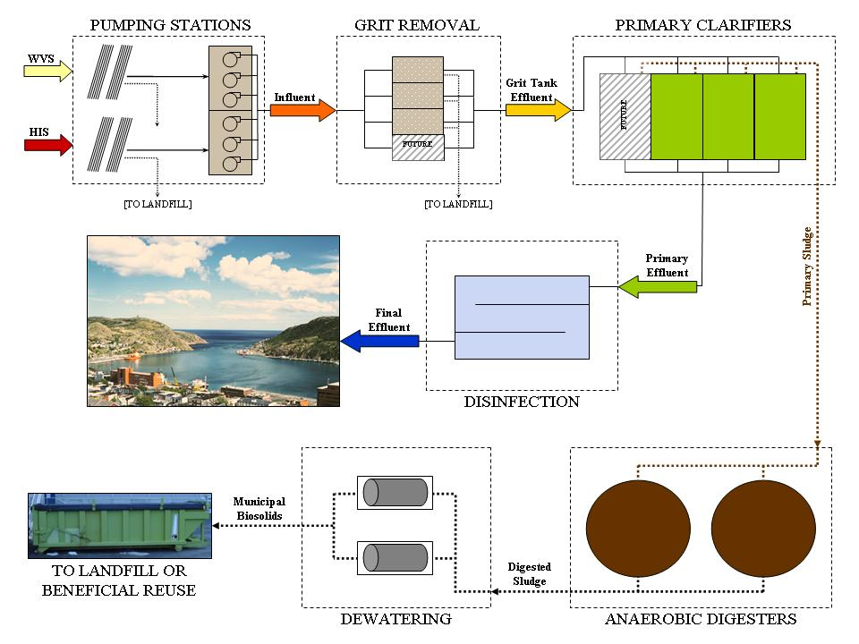
St. John’s Riverhead Wastewater Treatment Plant

