Slide 1
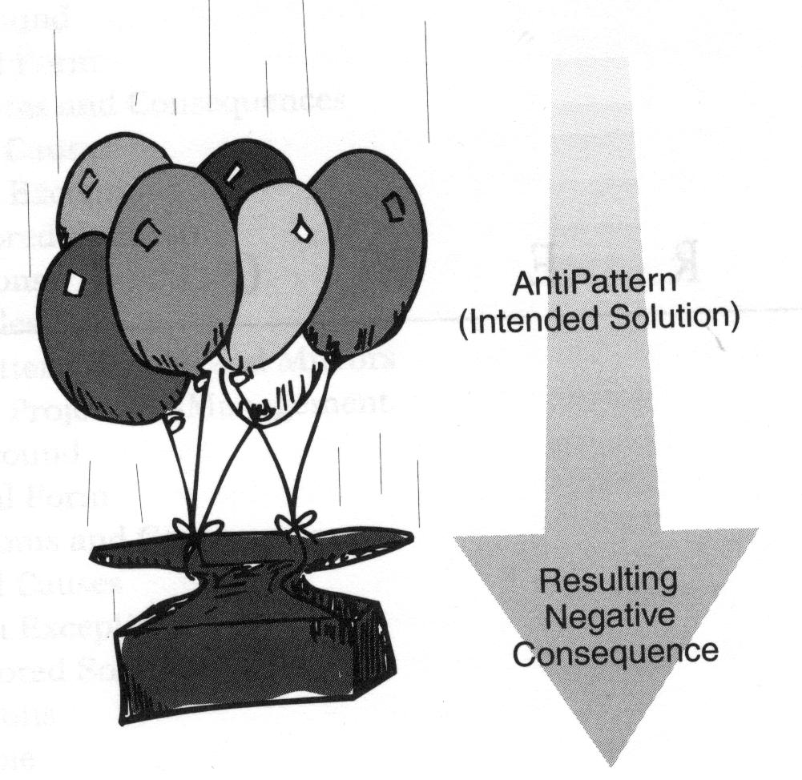
Anti-Patterns

Slide 2
What are Anti-Patterns
Anti-patterns are design patterns that may be commonly used but are ineffective and/or counter-productive in practice.
Often seem like a “good idea” at the time.

Slide 3
Why do we care?
To identify common mistakes
Not trying to say don’t do this, trying to say you probably don’t realize you’re doing this.

Slide 4
Organizational Anti-Patterns
Analysis Paralysis
  Spending too much time analysing the problem
Stovepipe
  Organizational structure that supports only up-flow of information
Escalation of commitment
  Failing to revoke a decision when it is wrong

Slide 5
Project Management Anti-Patterns
Death march
  Working extra on a project that has unreasonable deadlines
Software bloat
  Allowing successive versions of a system to use more resources

Slide 6
Common Anti-Patterns
Copy and Paste Programming
Programming by Accident
Programming by Permutation
Reinventing the Wheel
Reinventing aSquare Wheel

Slide 7
Common Anti-Patterns
Premature Optimization
Caching Failure
Magic Numbers
Improbability Factor
Complacency

Slide 8
Copy and Paste Programming
Copying code from one place and modifying it slightly to work where you paste it
Should create a reusable method
Argument: Faster to copy and paste therefore faster code development
Rebuttal: Maintenance of code becomes a nightmare when you change one piece of the copied code.

Slide 9
Programming by Accident
This happens when a programmer does not think the piece of code all the way through
This often leaves exceptions that need to be recoded for
No argument for this anti-pattern, it simply happens by not planning/thinking enough.

Slide 10
Programming by Permutation
Writing code you don’t really understand, often leading to problems
Problems are fixed by trial and error
This creates code that is difficult to understand and harder to debug

Slide 11
Reinventing the Wheel
Rewriting a piece of code that has already been written
Happens when people are unfamiliar with available libraries.

Slide 12
Reinventing a Square Wheel
Worse than reinventing the wheel, this code is not as good or has fewer features than the original option.
Some people say this this happens most often when porting to another platform, OS, or language

Slide 13
Premature Optimization
Trying to optimize code while you’re writing it (clever code)
This causes code that is hard to read and even harder to debug.
Instead, write the code so that it work, then optimize if there is performance issues.

Slide 14
Caching Failure
Forgetting to reset a variable between uses.
Eg. Throwing an error flag, and after the error is handled, leaving the error flagged.
No easy way to find or prevent this other than being careful

Slide 15
Improbability Factor
Extremely common – code is written knowing there could be errors.
That error is not programmed for as it could be hard to program for and considered unlikely to happen
Is there a problem with this?
Not until the error occurs

Slide 16
Magic Numbers
Consider this code:
      for(int i = 0; i < 52; i++){
      //some standard code here
      }
How many have seen some code like that?
What is the 52 for? Why 52? Why not 360?

Slide 17
Magic Numbers
In this case the 52 is the number of cards in a deck.
Not knowing that we were talking about cards, 52 is just a magic number
Code a variable and use the variable in the for loop rather than hard coding the number.
This makes the code more readable

Slide 18
Complacency
Simply put, this is when people fail to adapt to changing standards.
Code becomes out dated, inefficient and sometimes stops working as hardware/OS is updated.

Slide 19
References
http://c2.com/cgi/wiki?AntiPattern
http://en.wikipedia.org/wiki/Anti-pattern
http://systeminetwork.com/article/anti-patterns-avoid-programming-dark-side

Slide 20

Conclusion and Questions

