Slide 1
Cleanroom Software Engineering
A unique approach to software development

Slide 2
Cleanroom History

Slide 3
Harlan D. Mills
Theory developed thru 1970’s to mid 80’s by mathematician and IBM employee Harlan Mills and colleagues.
First seen use in the mid 80’s being selected for the ARPA STARS program
Military demonstrations of the theory began in the early 1990’s.
In 1990 IBM developed a Cleanroom Software Technology Centre
In 1995 a Operations research model was developed for use with Usage model
In 1996 an Enumeration theory was developed and the Cleanroom software methodology was mapped to CMM (Capability Maturity Model)

Slide 4
Why the name Cleanroom?

Slide 5
Manufacturing
Named after a manufacturing process used commonly for semiconductor production
Manufacturers work in a nearly ideal environment with limited or controlled amounts of pollutants
Prevents the introduction of defects instead of fixing them later
Software Development
Cleanroom methodology follows same principles as manufacturing
Developers work in a nearly ideal error free environment
Tries to limit the errors in software during the design and implementation stages instead of debugging later

Slide 6
Quick Overview

Slide 7
What is it? – Cleanroom software engineering (SE) is a process that focuses on mathematical verification of design and specifications before production, and then software certification during testing to provide near zero defects in its product.
Who does it? – Cleanroom SE is a unique development process and can only be performed by a highly trained software engineering
Why is it Important? – Errors and debugging in software engineering take time and money. With the Cleanroom approach these factors are removed or limited for efficient development.
What are the steps? – The Cleanroom process has a standard reference model that must be followed for maximum results this model will be discussed in the upcoming section.

Slide 8
Cleanroom Reference Model

Slide 9
Cleanroom uses a specialized version of the incremental process applying pipelining techniques
Each increment is eventually added together to create the entire system
Follows a 7 step process for each increment assuring that each component is certified reliable before moving on to the next component

Slide 10
Requirement Gathering / Increment Planning

Slide 11
Development begins with an overall product specification developed through standard system engineering processes
Project is adopted to an incremental strategy and each increment (functional component) is defined and planned from beginning to end
Detailed description of customer level requirements is descried for each functional increment
Gathering of requirements may lead to a simplified customer concept, or determining requirements that the customer may not have initially addressed.

Slide 12
Box Structure Specification

Slide 13
Once requirements have been established, the function and behavior of each increment must be defined.
Cleanroom SE uses a box structure specification to define the product.
The refining process begins as a general component overview (black box), refined to transitional state behavior (state box), and then finally to a functional description (clear box).
At the end of the process the development team should be left with a design resembling structured programming of their language of choice.

Slide 14
The Black Box
The black box represents an incremental component as a whole, and sits at the top of a hierarchy of software components
The black box reacts to stimuli and uses transition mapping rules to determine a response
The black box approach is further refined to include its state behavior and data in a state box.

Slide 15
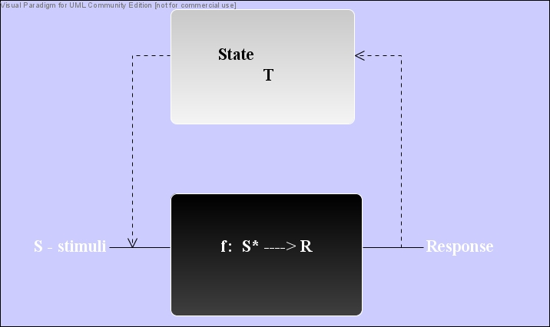
The State Box
The state box can be seen as a generalized state machine including state data and operations and incorporating the black box
The state box reacts to stimuli which causes a state transition and results in a response. State specific data (T) are also retained.
State boxes are crucial for showing the behavior of a system, and how it reacts and transitions due to user inputs

Slide 16
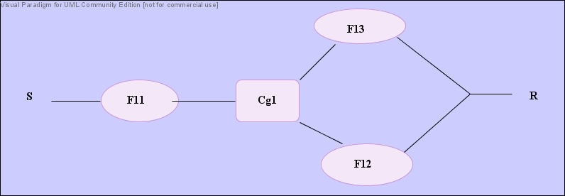
The Clear Box
The clear box breaks down the sub functions of the black box into procedural like descriptions that resemble structured programming
It shows the component in high detail down to the logical constructs of the programming code
Sub functions may be composed of other black boxes that have to be refined down to its own clear box.
At this stage, these specifications are able to be mathematically proven to be correct

Slide 17
Formal Design

Slide 18
Once box the structure specification is complete Cleanroom designing takes place
Cleanroom uses the structured programming philosophy to design its functions.
Functions in clear box spec. are systematically refined from mathematical functions to logical connectives that resemble a programming language.
Developers use the concepts of data encapsulation, information hiding and data typing to design the data of the product.
At this stage much of the design is able to implemented in the selected programming language of choice.

Slide 19
Correctness Verification

Slide 20
The formal design approach of the software's functions allow them to be mathematically verified for correctness using mathematical proofs
Each refinement of the design must be mathematically proven to be correct using general correctness conditions depending on the situation
The use of structured programming concepts allow for a function to be proven to be correct fairly easily compared to the unit testing approach
A single condition is required for sequences to be verified
2 conditions required for if-else statements
3 conditions for loop statements
Once all sub functions of a component are verified to be correct, coding implementation can begin.

Slide 21
Code Implementation & Inspection

Slide 22
Once design verification has been complete, the structured programming design method can easily be translated into the correct programming language
Similar to the design this code is also put through correctness verification
This process results in every line of code in the software to be verified to be functionally correct
After code verification team reviews and meetings are held for each component
Teams discuss any possible complications with the code, or any changes that may have recently occurred in the design
After all members agree on the design and implementation, the crucial Cleanroom testing strategy is applied

Slide 23
Statistical Quality Assurance Testing

Slide 24
Cleanroom testing using the SQA approach is fundamentally different then conventional testing methods
Instead of trying to determine test cases that uncover errors, Cleanroom testing tries to show that statistical amount of use cases function correctly
Testing teams first determine which use cases accurately describe the behavior of the system
Appropriate inputs and events are chosen based on these use cases
A probability distribution of these cases is calculated depending on usage scenarios, customer interviews and a general understanding of the product
A particular amount of randomly selected stimuli are then chosen to verify the program
Time is record to determine the MTTF which is a good calculation of software reliability

Slide 25
Software Certification

Slide 26
Once a component had gone through the design and testing phases it is ready to be certified
Certification in the Cleanroom context occurs when a component has reached a certain level of reliability based on its MTTF
There are 5 main steps involved with certification:
Usage scenarios
Usage profiles
Test cases
Recorded results (testing)
Reliability is computed and certified

Slide 27
Certification cont’d
The first 4 criteria specified are determined during the designing and testing phases.
The final certification requires 3 distinct models :
Sampling model
Component model
Certification model
The sampling model involves the certification of M random use cases
The component model involves certification of an entire component
The certification model evaluates the system as a whole
After statistical testing of each model, teams have enough information to calculate a certified MTTF
Certified components and their profiles can be stored and used in different software situations

Slide 28
Differences between other Formal Methods

Slide 29
Cleanroom development is unique in that it does not follow conventional methods
Applies all basic and fundamental concepts regarding software analysis and design however different greatly with regards to testing :
Cleanroom Method
Conventional Method
Uses SQA for testing
Verifies design and code using mathematical proofs of correctness
Uses statistical based testing to determine high probability errors
Uses test cases and unit testing
No formal verification of design or code
Unit testing and debugging to uncover and fix errors

Slide 30
Advantages of Cleanroom Development

Slide 31
Team orientated incremental pipelining approach allows for many components to be worked on concurrently therefore increasing productivity
Continuous team meetings/reviews along with statistical testing and correctness verification produce a far better quality code then unit testing and debugging which may lead to further errors
Rigorous formal design and specification methods and refinement lead to reduction in code size critical for embedded situations
Due to the improvement in software performance and the time and money saved due to significantly less testing revenue on software will readily increase
Finally, Cleanroom development certifies a software’s reliability and presents the user with a near zero defect product

Slide 32
Overall Performance Improvements
Productivity improvement – (200 to 400)%
Quality improvement – (10-100 : 1)
Code size reduction – (5:1)
Return on investment – (20:1)
Reliable certified software – Priceless

Slide 33
Obstacles facing Cleanroom widespread usage

Slide 34
Though there are obvious benefits for using the Cleanroom approach for development, the process has seen limited usage to date mainly because:
Developers believe the mathematical and statistical methodology is to radial for software development
The methods of SQA and statistical testing are so much different then the conventional method of unit testing and debugging
It is currently a much more advanced and complex type of development then ad-hoc level of the current industry
These factors have a huge impact of the use of this methodology
Cleanroom development worldwide spread is inevitable due to its numerous advantages previously discussed and the need for reliable near zero error software for critical situations

Slide 35
Cleanroom developed Software
IBM COBOL/SF restructuring tool
IBM AOExpert/MVS™ system outage analyzer
Ericsson Telecom OS32 operating system
IBM mass storage control unit adapters
SEL at NASA Goddard Space Flight Center
U.S. Army Picatinny Arsenal

Slide 36
Cleanroom Summary

Slide 37
Cleanroom design is fundamentally different then other design methods, spending much of its life cycle on design rather then testing
Errors found early in lifecycle minimizing rework and speeding time to market
Designs are straightforward and verifiable using the box structure specification and mathematical models
Maximum quality, and minimized cost are achieved through software verification and not testing
The Cleanroom development process is a formal methodology based on structured programming and a set of stepwise refinements and transformations from requirements to the actual implemented code in which each step is verified to minimize errors
The Cleanroom approach is the only method to fully verify a software program and to guarantee to its customer a certain level of reliability crucial for life critical or mission critical software products.

Slide 38
References
Richard C. Linger, Carmen J. Trammel. “Cleanroom Software Engineering Reference Model Version 1.o”. Technical Report. November 1996
C. L. Lui, Allen B. Tucker. “Software Engineering: A Practioners Approach 5th ed.”. Chapter 9 – Cleanroom Development. September 2001
Mills, H.; M. Dyer and R. Linger (September 1987). "Cleanroom Software Engineering". IEEE Software 4 (5): 19–25. doi:10.1109/MS.1987.231413.

Slide 39
Further Reading
Stavely, Allan (1999). Toward Zero-Defect Programming. Addison-Wesley.
Stacy J. Prowell and Carmen J. Trammell and Richard C. Linger and Jesse H. Poore (1999). Cleanroom Software Engineering: Technology and Process. Addison-Wesley.
Jesse H. Poore and Carmen J. Trammell (1996). Cleanroom Software Engineering: A Reader. NCC Blackwell.

