Slide 1
Robert Lockyer

Slide 2
Summary
The Tar Pit
The Mythical Man Month
The Surgical Team
Aristocracy, Democracy and System Design
Passing the word
The Whole and the parts
Notes:
The Tar Pit - Why Systems programming is so difficult, why it’s so fun
The Mythical Man Month -Why men and months are not interchangeable units
The Surgical Team - Suggestions on how to organize software teams
Aristocracy, Democracy and System Design - How to maintain coherence of a system
Passing the word – Team communication
The Whole and the Parts – Debugging philosophies

Slide 3
The Tar Pit
Large systems programming is a tar pit
Most emerge with running systems
Few meet goals, schedules and budgets
Small groups seem much more efficient
They only build Programs, not Programming Systems Products

Slide 4
A
Program
A
Programming
System
3X
3X
A
Programming
Product
A
Programming
Systems
Product
Notes:
Programming System
Interfaces, System Integration
Programming Product
Generalization, Testing, Documentation, Maintenance
Programming systems project takes nine times as long as a program

Slide 5
The Mythical Man-Month
Cost varies as a function of the number of men and months, progress does not.
Men and months are not interchangeable in software development.
Men and months are interchangeable only when a task can be partitioned among many workers with no communication among them.
Notes:
This is true of reaping wheat or picking cotton; it’s not even approximately true of systems programming. The bearing of a child takes nine months no matter how many women are assigned.

Slide 6
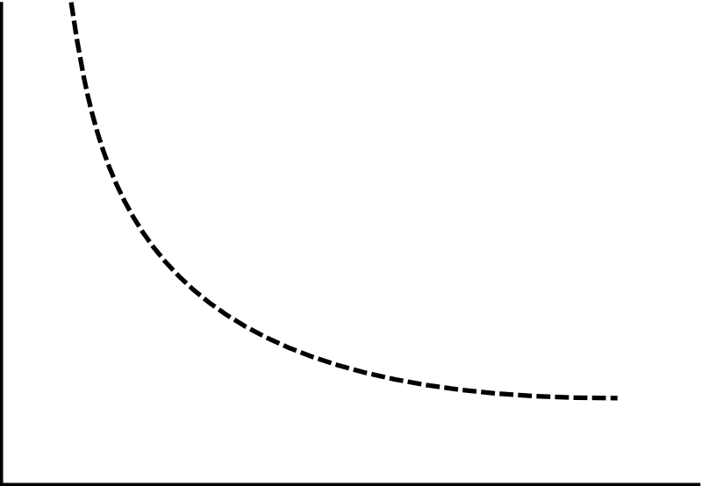
perfectly partitionable task
Months
Men

Slide 7
unpartitionable task
Months
Men

Slide 8
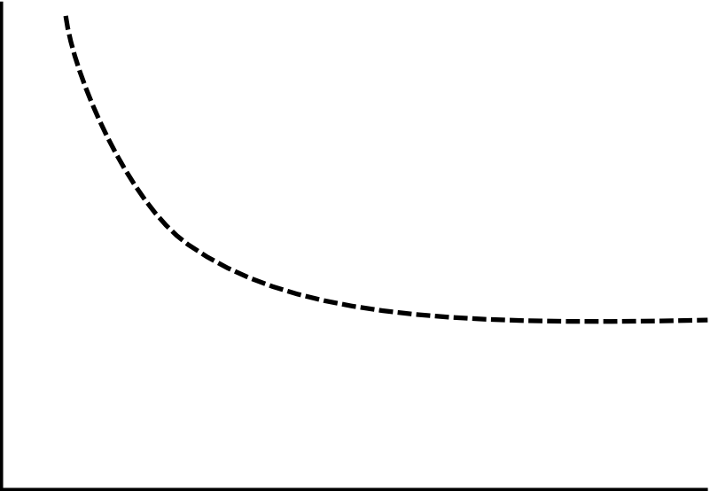
partitionable task requiring communication
Months
Men

Slide 9
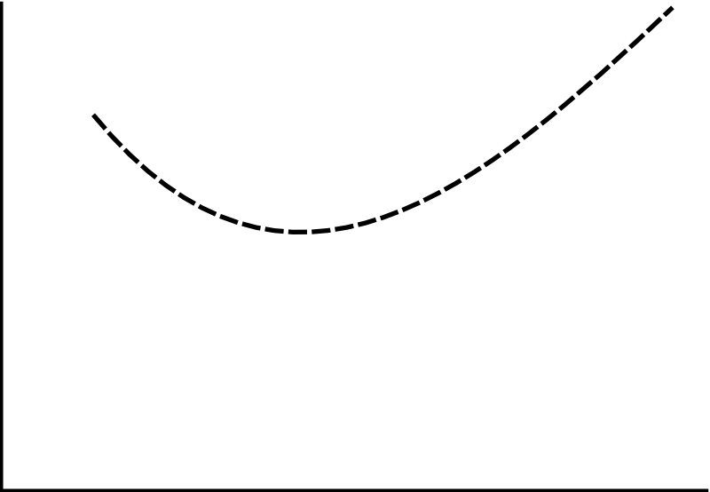
task with complex interrelationships
Months
Men
Brooks’s Law: Adding manpower to a late software project makes it later

Slide 10
Schedule
Rule of thumb
1/3 for design
1/6 for coding
1/4 for component testing
1/4 for system testing
As a discipline we lack estimating data

Slide 11
The Surgical Team
There are major productivity variations between good programmers and poor ones (on the order of 10x)
We want to build a system using as few minds as possible, to avoid unnecessary communication and maintain structural coherence.
The problem is that large projects require many hands.
The solution may lie in how we organize people
Key is to reduce needed communication

Slide 12
Mills’s Proposal
The Surgeon
Chief programmer
The Copilot
Alter ego of surgeon, can do any job but less experienced
Surgeon gets final say on all decisions
The Administrator
Surgeon is boss, but shouldn’t be involved in the bureaucratic details

Slide 13
Mills’s Proposal
The Program Clerk (automate?)
Keeper of program input/output data
The Editor
Surgeon writes docs, editor criticizes, reworks, etc
Two Secretaries
Admin and Editor need one each

Slide 14
Mills’s Proposal
The Tool Smith
Builds custom tools and processes for the surgeon
The Tester
Surgeons adversary, builds tests based on specs and helps devise test data for debugging
The Language Lawyer
Delights in the obscurities of a programming language
One can serve two or three surgeons

Slide 15
Aristocracy, Democracy, and System Design
Problem: How do we maintain conceptual integrity of a project?
Small architecture team alone should alone write all external specifications
Architecture means: Complete and detailed specification of the user interface

Slide 16
Aristocracy, Democracy, and System Design
The implementers raise three objections:
The specs will be too rich in function, will not be practical
The architects will get all the creative fun and shut out the inventiveness of the implementers
The many implementers will have to sit idly by while specifications are written
Notes:
Conceptual Integrity
Small architecture team should alone write all external specifications
The implementers raise three objections:
The specs will be too rich in function, will not be practical
This requires a feedback loop between architects and implementers. Architect gets
estimates from the implementers as he designs the system, adjusts accordingly.
The architects will get all the creative fun and shut out the inventiveness of the implementers.
Discipline is good for art, The external provision of architecture enhances, not cramps, the
creative style of the implementing group.
The many implementers will have to sit idly by while specifications are written
Not true, can generally proceed in parallel, architects will need to consult implementers
for estimates

Slide 17
Passing the word
Architecture specs must not only describe what the user can see, must refrain from describing what the user does not see.
Must define what is not prescribed as carefully as what is.
“Never go to sea with two chronometers, take one or three”
Always have one definition as standard. All others are subservient.

Slide 18
Passing the word
Changes to the manual should be made clear to developers implementing that functionality. Highlight in logbook/wiki whatever system in use
Implementers must be able to easily contact architect for clarification. These conversations must be made available to anyone concerned.

Slide 19
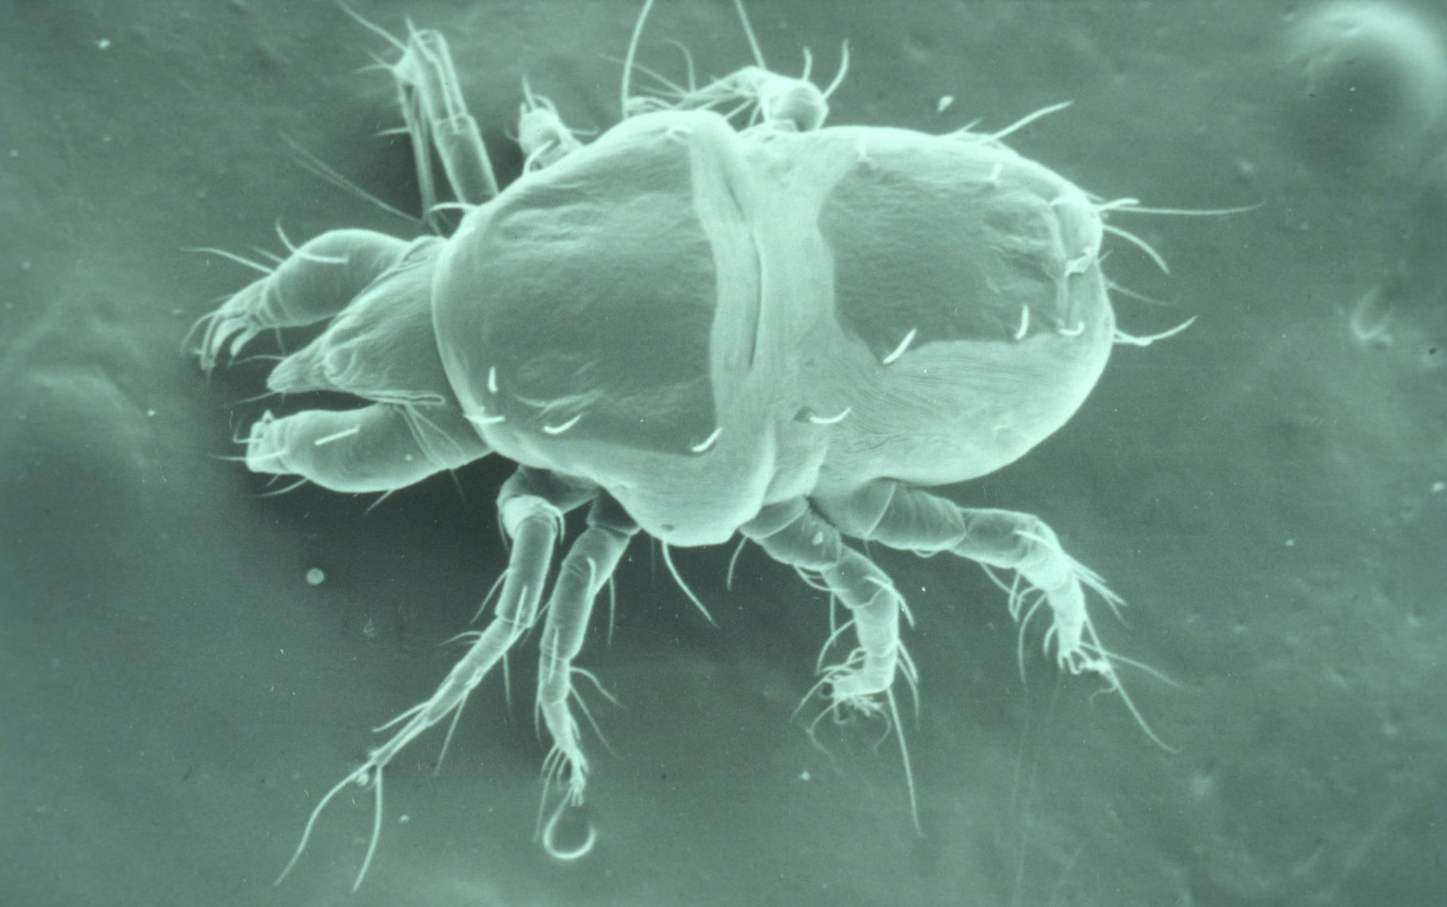
The Whole and the Parts
Build plenty of scaffolding
It’s not unreasonable for there to be half as much code in scaffolding as there is in product
Add one component at a time
Laziness temps us to violate it, requires extensive scaffolding, maybe there are no bugs…
There ARE bugs, so it’s worth building the scaffolding.

Slide 20
Review
The Tar Pit
The Mythical Man Month
The Surgical Team
Aristocracy, Democracy and System Design
Passing the word
The Whole and the Parts

Slide 21
References
The Mythical Man-Month: Essays on Software Engineering, Frederick P. Brooks, Jr. (University of North Carolina at Chapel Hill) 1986
Wikipedia: IBM System/360
http://en.wikipedia.org/wiki/IBM_System/360

Slide 22
Questions?

